Slide 1
Test Suite Reduction for Self-organizing Systems: A Mutation-based Approach
André Reichstaller, Benedikt Eberhardinger, Hella Ponsar, Alexander Knapp, Wolfgang Reif
Software & Systems Engineering, Universität Augsburg

Slide 2
Testing meets AI
Test Suite Reduction
„Identify a reduced test suite that provides the same coverage of the software as the original test suite” (Jones and Harrold 2004)
$$!\max_{T^{′}⊂ T}{\frac{\left|∪_{t^{′}∈T^{′}}CC\left(t′\right)\right| }{|∪_{t∈T}CC\left(t\right)|}}$$
Rep. Subset Selection
„Finding a subset of a large number of models or data points, which preserves the characteristics of the entire set” (Elhamifar 2016)
$$!\min_{T^{′}⊂ T}{\sum_{t^{′}∈T^{′}}{\arg{\min_{t∈T}{dist(t,t^{′})}}}}$$
Question: Can we solve Test Suite Reduction with Rep. Subset Selection approaches?
Experiment: Mutation-based Test Suite Reduction for Self-organizing Systems
Notes:
According to the special theme of the workshop this year we investigate an intersection between AI and Testing
In particular, we consider to solve the Test Suite Reduction Task by Machin Learning Approaches on Rep. Subset Selection
Read out definition for TSR
Given a test suite T we search for a reduced test suite T‘ that maximizes the ratio of coverage, given a particular coverage criterion. 1 would be the optimum – we would have eliminated redundancy.
CC -> Coverage Criterion
Read out definition for RepSubSe
Here we are searching for a subset of data points. We want to minimize the sum of pairwise distances between all the data points to the represenatives.
Read out the question
This would be nice as we could use proven and mostly efficient techniquse for RepSubSe for the TSR task which is generally seen as being rather complex.
For this workshop we investigated this intersection and possible translations for the first to the second on a particular example. Read out.
Before i present our methodolgy and the results of experement im going to start with some basics about self-organizing systems and mutation testing.

Slide 3
Self-organizing Systems
Reconfiguration Mechanism
Distributed software agents continuously interact with their environment
2
The joint system behavior is strongly influenced by inter-agent communication
1
3
2
$$A_{S}$$
1
$$S$$
3
If an agent detects an environmental fault that hinders the current system approach it triggers a reconfiguration mechanism which then computes and distributes a valid configuration again
Notes:
Self-organizing systems are distributed, reactive systems with the particular characteristic that they are able to adapt their structure at run-time to unforeseen environmental disturbances.
Distribution: meaning (1)
Reactivity: meaning (2)
Adaptation: meaning (3) . This is often implemented through message passing.

Slide 4
Testing Self-organizing Systems
Reconfiguration Mechanism
Goal: Finding faults by revealing failures
3
2
$$A_{S}$$
$$S$$
Test Process
1
Test Suite
$$S$$
$$A_{T}$$
Test Case: Executing $a∈A_{T}$ in a $s∈S$
A test suite $TS⊆S×A_{T}$ derived by S# encapsulates a number of test cases.
Observed Transition: $T_{obs}∈S×A_{T}×A_{S}×S$
Notes:
Testing those systems basically means to mimic or trigger disturbances by a test process and evaluating if the system adapts correctly.
The goal is classically finding faults by revealing failures.
A test case is performing a test step or input from a particular state – leading to an observed transition which appends the observed system action as well as the reached states.
The test suite is a subset of all possible test cases.
We use the tool S# to derive such a test suite. Using a model checker, this tool exhaustively triggers all imaginable disturbances leading to a huge bunch of test cases.
Our task is now to reduce this test suite.

Slide 5
Task: Test Suite Reduction
„Identify a reduced test suite that provides the same coverage of the software as the original test suite” (Jones and Harrold 2004)
Reconfiguration Mechanism
Here: Mutation Coverage
Goal: Finding faults by revealing failures
3
2
$$A_{S}$$
$$S$$
Test Process
1
Test Suite
$$S$$
$$A_{T}$$
Test Case: Executing $a∈A_{T}$ in a $s∈S$
A test suite $TS⊆S×A_{T}$ derived by S# encapsulates a number of test cases.
Observed Transition: $T_{obs}∈S×A_{T}×A_{S}×S$
Notes:
Here again the characterization of this task: read off
We use mutation coverage coverage here. What does this mean?

Slide 6
Mutation Testing
Reference Version
Mutation
Operators
MOP1
MOP2
MOP3
Mutation operators mimic particular, common errors
Mutants
Mutant 1
Mutant 2
Mutant 3
Mutants are programs that simulate the effect
of introduced errors and thus potentially comprise faults.
Killing set: Revealed mutants
Mutation Coverage: |Killing Set|/|Mutants|
TC
Notes:
Some words about mutation testing
Mutation testing is a fault-based method for assuring the quality of test cases.
We simulate failures by artificially introducing common errors – those are mimicked by mutation operators, one for each error.
A number of modified versions of the reference version is generated by applying the given mutation operators.
The resulting modiﬁcations of p, the so-called mutants, are programs that simulate the effect of introduced errors and thus potentially comprise faults
For evaluating a test case, each of the mutants is executed with it.
If TC is able to differ the mutant from the reference version, i.e., the test case fails, we say it killed the mutant - it would have found the fault in reality.
Some terminology: the killing set of the test case comprises the revealed mutants and the coverage is the ratio of the found mutants.

Slide 7
Mutation Testing
Reference Version
Mutation
Operators
MOP1
MOP2
MOP3
Mutation operators mimic particular, common errors
Mutants
Mutant 1
Mutant 2
Mutant 3
Mutants are programs that simulate the effect
of introduced errors and thus potentially comprise faults.
Killing set: Revealed mutants
Mutation Coverage: |Killing Set|/|Mutants|
TC
TC
TC
Notes:
For a whole set of test cases, a test suite, we have to
First: evaluate each test case for each mutant leading to a
Killing set which is the union of all killed mutants.

Slide 8
Mutation Testing
Hypotheses:
Competent programmer hypothesis
Coupling effect
Reference Version
Mutation
Operators
MOP1
MOP2
MOP3
Mutation operators mimic particular, common errors
Mutants
Mutant 1
Mutant 2
Mutant 3
Mutants are programs that simulate the effect
of introduced errors and thus potentially comprise faults.
Killing set: Revealed mutants
Mutation Coverage: |Killing Set|/|Mutants|
TC
TC
TC
Notes:
There are traditionally 2 hypotheses in mutation testing
First: The programmer will not fully fail – we do not have to consider weird combinations
Second: revealing one error – i.e., FOM will mostly suffice, as higher order mutants, i.e., combinations aint reachable then.
Both hypotheses thus suggest that we can normally concentrate on obvious patterns of FOM and do not have to consider HOMs.

Slide 9
Mutation Testing
Hypotheses:
Competent programmer hypothesis
Coupling effect
Reference Version
Mutation
Operators
MOP1
MOP2
MOP3
Mutation operators mimic particular, common errors
Mutants
Mutant 1
Mutant 2
Mutant 3
Mutants are programs that simulate the effect
of introduced errors and thus potentially comprise faults.
Killing set: Revealed mutants
Mutation Coverage: |Killing Set|/|Mutants|
TC
TC
TC
Notes:
Intro:
Bridge:
To apply this concept to our problem we need both
adequate mutation operators for the SUT type considered and
a method for determining the test cases
to apply this TSr for SO systems? and how to find the optimal subset w.r.t. the mutation score / coverage? <- We need mutation operators and we try to solve this by rewording.

Slide 10
Mutation Operators
Hypotheses:
Competent programmer hypothesis
Coupling effect
Reference Version
Mutation
Operators
MOP1
MOP2
MOP3
Mutation operators mimic particular, common errors
Mutants
Mutant 1
Mutant 2
Mutant 3
Mutants are programs that simulate the effect
of introduced errors and thus potentially comprise faults.
Killing set: Revealed mutants
Mutation Coverage: |Killing Set|/|Mutants|
TC
TC
TC
Notes:
Let‘s start with the operators.

Slide 11
Mutation Operators
Reconfiguration Mechanism
3
2
$$A_{S}$$
1
$$S$$
3
If an agent detects an environmental fault that hinders the current system approach it triggers a reorganization mechanism which then computes and distributes a valid configuration again
Notes:
For experiments we wanted to concentrate on the special characteristic of SO systems
It is its ability to reconfigure.
Remember: This is the type 3 of communication
Read off again.
We derived the following mutation operators

Slide 12
Mutation Operators
Reconfiguration Mechanism
Needless Reconfiguration Message (NRM)
False Reconfiguration (FR)
3
2
$$A_{S}$$
1
$$S$$
Lost Reconfiguration
Message (LRM)
3
If an agent detects an environmental fault that hinders the current system approach it triggers a reorganization mechanism which then computes and distributes a valid configuration again
Notes:
False Reconfiguration:
This operator mimics the loss of a message that was sent by the reconﬁguration mechanism to trigger adaption. In consequence, one agent will (maybe erroneously) retain its previous internal state—this could result again in an incorrect system conﬁguration.
2) Lost Refonfiguration Message
As soon as an agent ﬁnds that a predicate of the invariant is violated it should normally send a reconﬁguration message to trigger the reconﬁguration mechanism. This mutation operator suppresses such messages, such that there might be no reconﬁguration in spite of an incorrect system conﬁguration.
3) Needless Reconfiguration Message
The inverse of an LRM: A particular agent signals the violation of a predicate, although there actually is none. Consequently, unnecessary reconﬁguration steps might be triggered.

Slide 13
Higher Order Mutants
Does the coupling effect exist?
Reconfiguration Mechanism
Needless Reconfiguration Message (NRM)
False Reconfiguration (FR)
3
1
$$A_{S}$$
2
$$S$$
Lost Reconfiguration
Message (LRM)
Notes:
Given those operators we wondered: does the coupling effect exist? And we found two exceptions where this was not the case, meaning that
* Killing FOMs is not enough.

Slide 14
Higher Order Mutants
Does the coupling effect exist?
Reconfiguration Mechanism
Needless Reconfiguration Message (NRM)
False Reconfiguration (FR)
3
1
$$A_{S}$$
2
$$S$$
Lost Reconfiguration
Message (LRM)
LRM
NRM
Failure Masking
Notes:
The first problem is failure masking:
Two or more injected system faults might mask the effect of one another. If so,their combination cannot be killed by any test case of the suite.
Effect: A test case that was originally selected for revealing failures from one of these faults might falsely pass in real operation if the program comprises both.
One robot erroneously sends a reconfiguration message while another does erroneously not.
Considering these faults separately we would either observe that no reconfiguration took place although it should or that a reconfiguration was unnecessarily triggered.
In combination, however, a reconfiguration takes place and offers the chance that a correct configuration is chosen.

Slide 15
Higher Order Mutants
Does the coupling effect exist?
Reconfiguration Mechanism
Needless Reconfiguration Message (NRM)
False Reconfiguration (FR)
3
1
$$A_{S}$$
2
$$S$$
Lost Reconfiguration
Message (LRM)
LRM
NRM
LRM
LRM
Failure Masking
Failure in Combination
Notes:
The second problem is failure in combination.
Particular failures might only be visible if the program comprises two or more system faults at the same time.
If so, the test suite contains test cases not revealing one of the separate faults but doing so for the combination.
Effect: If we exclusively consider FOMs, each of those cases reduces the probability to reveal the HOM in real operation.
If this probability goes to zero, i.e., the reduced test suite will not include a test case that covers the failure anymore.
Instance: Two robots identify environmental faults that need to be signaled.
If one of the robots erroneously not sends a reconfiguration message, there might be no failure as the other robot triggers a reconfiguration though. However, if both robots do not send a reconfiguration message the failure occurs.
All in all we thus need to consider HOM, too.

Slide 16
Mutation Testing with Second Order Mutants
Reference Version
Mutation
Operators
MOP1
MOP2
MOP3
Mutation operators mimic particular, common errors
Mutants
Mutant 1
Mutant 2
Mutant 7
Mutants are programs that simulate the effect
of introduced errors and thus potentially comprise faults.
SOM 1
SOM 2
SOM 3
SOM 4
SOM 5
SOM 6
TC
TC
TC
Notes:
But if we do consider HOM‘s as well,
This exponentially increases the effort for mutation testing.
Here we just introduced second order mutants, i.e., the combination of two mutation operators respectively.
And even here we can see the huge number of needed test case executions
This puts even more pressure on the methodology for finding test cases in the most efficient way!

Slide 17
Mutation Coverage
Reconfiguration Mechanism
$$!\max{\frac{\left|∪_{t^{′}∈T^{′}}CC\left(t′\right)\right| }{|∪_{t∈T}CC\left(t\right)|}}$$
3
2
$$A_{S}$$
$$S$$
Test Process
$$!\max{\frac{\left|∪_{t^{′}∈T_{obs}^{′}}K\left(t′\right)\right| }{|∪_{t∈T_{obs}}K\left(t\right)|}}$$
1
$$A_{T}$$
Test Suite
$$S$$
$$!\min{\sum_{t^{′}∈T_{obs}^{′}}{\arg{\min_{t∈T_{obs}}{dist(t,t^{′})}}}}$$
$$!min{\sum_{t^{′}∈T^{′}}{\arg{\min_{t∈T}{dist(t,t^{′})}}}}$$
Notes:
As stated before we want to use methods normally used for representative subset selection
This is the optimization criterion here
To do so we need to find a translation from the test suite optimization criterion here
Both can be refined to the instantiation with observed transitions and killing set, i.e., mutation coverage criterion, in our case
What we needed is a distance function between test cases which compares killing sets of test cases

Slide 18
Mutation Coverage
$$label vector v:$$
$$\left|v\right|=\left|MOP\right| and v_{i}=1 if$$
$$Mutant\left(M{OP}_{i}\right)∈K\left(t\right) else 0$$
Reconfiguration Mechanism
$$!\max{\frac{\left|∪_{t^{′}∈T^{′}}CC\left(t′\right)\right| }{|∪_{t∈T}CC\left(t\right)|}}$$
3
2
$$A_{S}$$
$$S$$
Test Process
$$!\max{\frac{\left|∪_{t^{′}∈T_{obs}^{′}}K\left(t′\right)\right| }{|∪_{t∈T_{obs}}K\left(t\right)|}}$$
1
$$A_{T}$$
Test Suite
$$S$$
$$!\min{\sum_{t^{′}∈T_{obs}^{′}}{\arg{\min_{t∈T_{obs}}{dist(t,t^{′})}}}}$$
$$!min{\sum_{t^{′}∈T^{′}}{\arg{\min_{t∈T}{dist(t,t^{′})}}}}$$
Notes:
Intermediate step: we introduce a so-called label vector
It is a binary representation of which of the mutants a test case killes
So for each mutation operator it comprises a 1 if it killed the generated mutant and a 0 otherwhise

Slide 19
Mutation Coverage
$$label vector v:$$
$$\left|v\right|=\left|MOP\right| and v_{i}=1 if$$
$$Mutant\left(M{OP}_{i}\right)∈K\left(t\right) else 0$$
Reconfiguration Mechanism
$$!\max{\frac{\left|∪_{t^{′}∈T^{′}}CC\left(t′\right)\right| }{|∪_{t∈T}CC\left(t\right)|}}$$
3
2
$$A_{S}$$
$$S$$
Test Process
$$!\max{\frac{\left|∪_{t^{′}∈T_{obs}^{′}}K\left(t′\right)\right| }{|∪_{t∈T_{obs}}K\left(t\right)|}}$$
1
$$A_{T}$$
Test Suite
$$S$$
$$dist\left(t, t^{′}\right)= dist\left(t.v_{1}, {t^{′}.v}_{2}\right)=$$
$$\left|\{l∈\left\{1,…,n\right\}\right|v_{1}\left[l\right]≠v_{2}\left[l\right]\}|$$
$$!\min{\sum_{t^{′}∈T_{obs}^{′}}{\arg{\min_{t∈T_{obs}}{dist(t,t^{′})}}}}$$
$$!min{\sum_{t^{′}∈T^{′}}{\arg{\min_{t∈T}{dist(t,t^{′})}}}}$$
Notes:
Having such a label vector given for each test case we now used the hamming function as distance measure
The more different the patterns of 1s and 0s the higher the distance and the more similar they are the lower the distance
Note that those patterns work for considering higher order mutants, too; as the more similar the patterns the more similar also the covered higher order mutants.

Slide 20
Mutation Coverage
$$label vector v:$$
$$\left|v\right|=\left|MOP\right| and v_{i}=1 if$$
$$Mutant\left(M{OP}_{i}\right)∈K\left(t\right) else 0$$
Reconfiguration Mechanism
$$!\max{\frac{\left|∪_{t^{′}∈T^{′}}CC\left(t′\right)\right| }{|∪_{t∈T}CC\left(t\right)|}}$$
3
2
$$A_{S}$$
$$S$$
Test Process
Hypothesis: Optimizing the representative subset selection problem optimizes the test suite reduction problem, too.
$$!\max{\frac{\left|∪_{t^{′}∈T_{obs}^{′}}K\left(t′\right)\right| }{|∪_{t∈T_{obs}}K\left(t\right)|}}$$
2
$$S$$
Test Suite
$$S$$
$$dist\left(t, t^{′}\right)= dist\left(t.v_{1}, {t^{′}.v}_{2}\right)=$$
$$\left|\{l∈\left\{1,…,n\right\}\right|v_{1}\left[l\right]≠v_{2}\left[l\right]\}|$$
$$!\min{\sum_{t^{′}∈T_{obs}^{′}}{\arg{\min_{t∈T_{obs}}{dist(t,t^{′})}}}}$$
$$!min{\sum_{t^{′}∈T^{′}}{\arg{\min_{t∈T}{dist(t,t^{′})}}}}$$
Notes:
Given that, our hypothesis is … read off

Slide 21
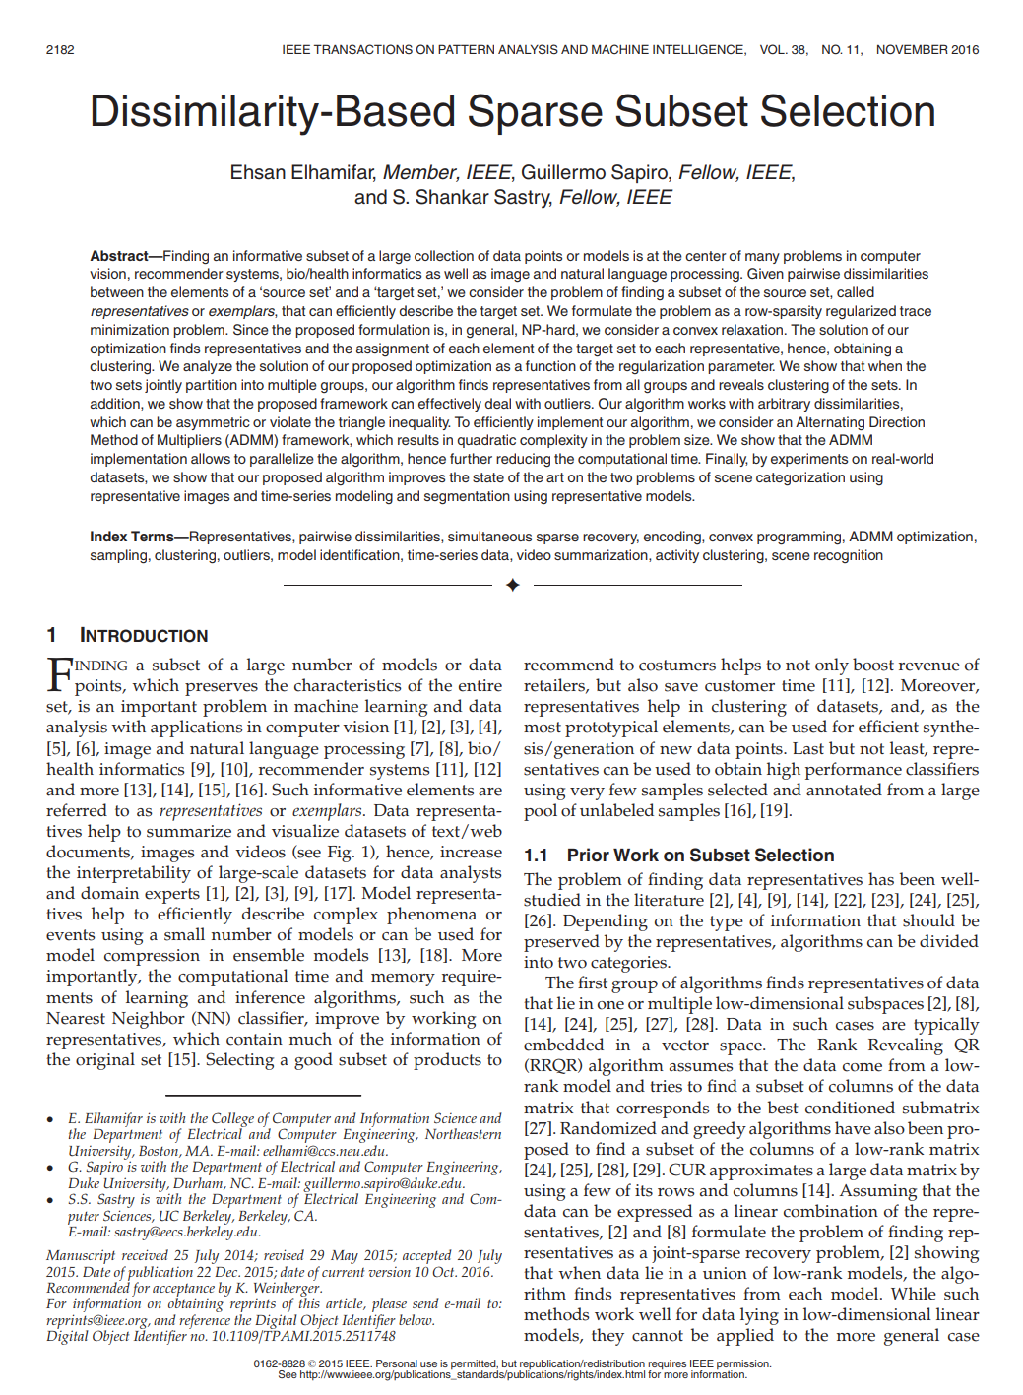
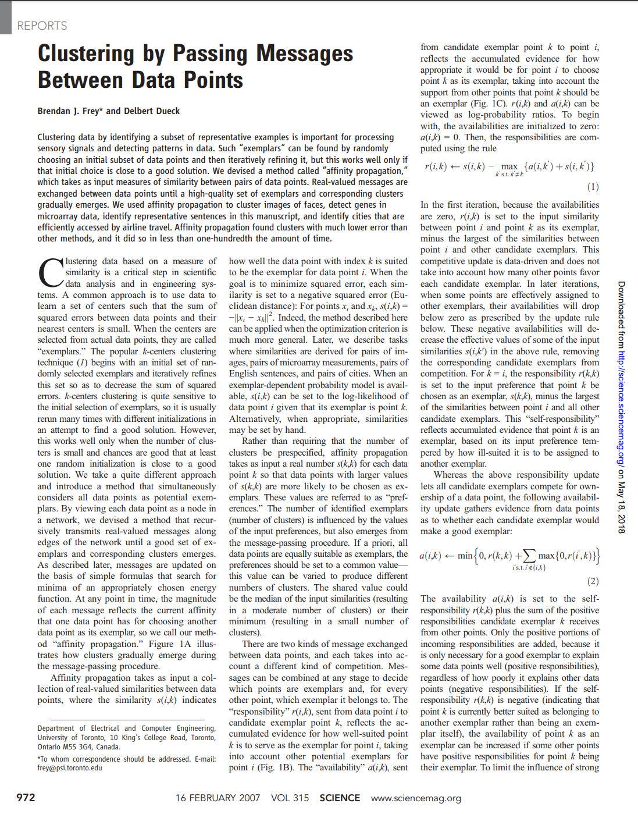
Solution Methods
Dissimilarity-Based Sparse Subset Selection (DS3)
Affinity Propagation
Notes:
To investigate this on our experiments we used two approaches on representative subset selection.
For both there are implementations/frameworks available which can be used - and where used by us
Note that there are many more alternatives we did not investigate yet because there are no implementations available or because of other disadvantages
Read off
I will now briefly discribe both methods without going into detail about the math behind ☺

Slide 22
Dissimilarity-Based Sparse Subset Selection
Optimization Program
$d_{ij}$ indicates pairwise distance
$z_{ij}$ indicator of $x_{i}$ representing $y_{j}$
$z_{ij}∈\{0,1\}$
$\sum_{i=1}^{N}{z_{ij}=1}$
Trace Minimization
Goal: Find few representatives that well encode $Y$
$||.|{\left.​\right|}_{p}$ denotes the $l_{p}−norm$
$I\left(.\right)$ denotes the indicator function
$λ>0$sets the trade-off between the two terms
Convex Relaxation
Sum of $l_{p}$-norms instad of counting
$z_{ij}∈\left[0,1\right]$ acting as probability that $x_{i}$ representing $y_{j}$
Convex for $p≥1$
Implementation through ADMM
Ehsan Elhamifar and S.Shankar Sastry 2016
Notes:
Given a set of data points Y and pairwise distances or dissimilarities between them, the DS3 forms a convex optimization program for finding few representatives that well encode Y
To do so they construct two matrices D and Z where D includes the distances an Z indicates the representatives and formulate two terms to optimize with given constraints
The resulting trace minimization problem is then finally relaxed in a way that it can be solved by the framework of ADMM Alternating Direction Method of Multipliers
The alternating direction method of multipliers (ADMM) is an algorithm that solves convex optimization problems by breaking them into smaller pieces, each of which are then easier to handle. It has recently found wide application in a number of areas.

Slide 23
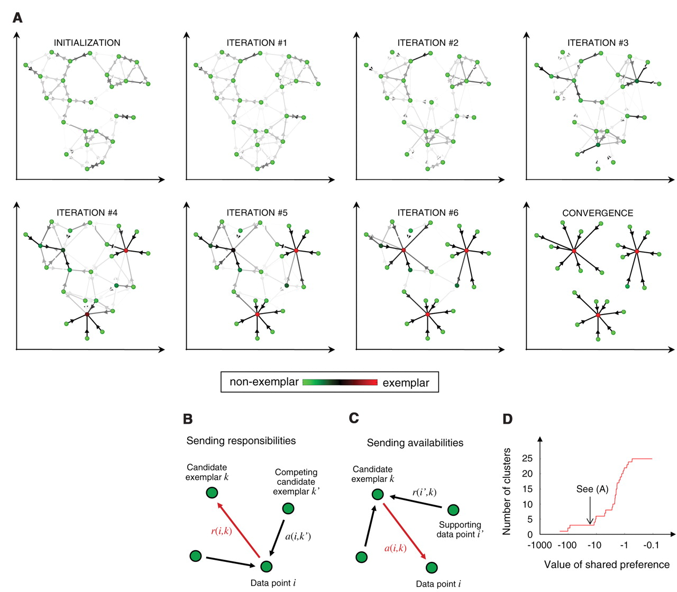
Affinity Propagation
Clustering data points ${X:= x}_{i}, …, x_{n}$ based on „Message Passing“
Similarity function $s:X×X→ℝ$
Diagonal of $s\left(i,i\right)$ represents the input preference and controls how many classes the algorithm produces
Responsibility $r(i,k)$: how well-suited $x_{i}$is to represent $x_{k}$
Availability a(i,k): how appropriate it would be for $x_{i}$ to pick $x_{k}$as an examplar
$$r\left(i,k\right)←s\left(i,k\right)−\max_{k^{′}≠k}\left\{a\left(i,k^{′}\right)+s\left(i,k^{′}\right)\right\}$$
$$a\left(i,k\right)←min⁡(0,r\left(k,k\right)+\sum_{i^{′}≠\left\{i,k\right\}}{\max\left(0,r\left(i^{′},k\right)\right)}$$
$$for i≠k and a\left(k,k\right) ←\sum_{i≠k}{\max\left(0,r\left(i^{′},k\right)\right)}$$
$\arg{\max_{k}{a\left(i,k\right)+r\left(i,k\right)}}$identifies point $i$ as an exemplar if $k=i$ or identifies the exemplar for point $i$
Brendan J. Frey and Delbert Dueck 2007
Notes:
.How affinity propagation works.
Affinity propagation is illustrated for two-dimensional data points, where negative Euclidean distance (squared error) was used to measure similarity. Each point is colored according to the current evidence that it is a cluster center (exemplar). The darkness of the arrow directed from point i to point k corresponds to the strength of the transmitted message that point i belongs to exemplar point k.
(B) “Responsibilities” r(i,k) are sent from data points to candidate exemplars and indicate how strongly each data point favors the candidate exemplar over other candidate exemplars.
(C) “Availabilities” a(i,k) are sent from candidate exemplars to data points and indicate to what degree each candidate exemplar is available as a cluster center for the data point.
(D) The effect of the value of the input preference (common for all data points) on the number of identified exemplars (number of clusters) is shown. The value that was used in (A) is also shown, which was computed from the median of the pairwise similarities.

Slide 24
Experiment: An Adaptive Production Cell
Reconf.
Robots (R1, R2, R3, R4) are equipped with toolboxes and the ability to change their tools
Each robot processes incoming work pieces according to its current role
Mobile carts (C1, C2, C3) carry work pieces
A task is completed by resource flow between the robots
Reconfiguration means to change the robots‘ roles
Depicted Task: Drill, Insert, Tighten, Polish
Notes:
Let us come to the experimental case
As experimental case we considered an adaptive production cell comprising 4 robots and 3 carts.
Read off
After R4 loses its polishing tool the resource flow is reconfigured: R3 is taking over the previous role of R4
A state thus comprises the current tasks, state of work pieces and, important, the current role allocation

Slide 25
The Problem with Self-adaptivity: We have to consider test sequences!
Reconf.
Problem: We cannot directly set particular role configurations.
Each test case starts from a source configuration
We consider test sequences $Π∈{\left(S×A_{T}\right)}^{∗}$ rather than single test cases
$$dist\left(π_{1}, π_{2}\right)=\sum_{tc_{2}∈π_{2}}{\min_{tc_{1}∈π_{1}}{dist(tc_{1},tc_{2}) }}$$
Notes:
And – this is a technical note – is not explicitely settable by the tester
To execute a particular test case we thus first had to establish the needed role allocation by manipulating the environment and the reconfiguration mechanism; one can say we had to outwit the reconfiguration mechanism
In consequence we however had to consider whole test sequences rather than single test cases – and to lift the distance function to still apply the Rep. Subset Selection Methods
We did so by simply summing up the minimum distances of comprised test cases of two paths

Slide 26
Results
Test suite comprised 500 sequences from 7524 test cases; 6245 mutants to kill
Parameters for AP:
$pref$: equally drawn from$\left[m−2, m+2\right]$ where $m$is the median of similarities in $s$
$maxIter$: 3000
Parameters for DS3:
$p (controlling λ)$: equally drawn from [0.001,0.005]
$maxIter$: 3000
Notes:
We evaluated our approach than for 500 generated test sequences over 7524 test cases.
Using the described mutation operators we introduced 6245 mutants to kill
Informal trial and error search!

Slide 27
Conclusion & Future Work
Test Suite Reduction
„identify a reduced test suite that provides the same coverage of the software as the original test suite” (Jones and Harrold 2004)
$$!\max_{T^{′}⊂ T}{\frac{\left|∪_{t^{′}∈T^{′}}CC\left(t′\right)\right| }{|∪_{t∈T}CC\left(t\right)|}}$$
Rep. Subset Selection
„Finding a subset of a large number of models or data points, which preserves the characteristics of the entire set” (Elhamifar 2016)
$$!\min_{T^{′}⊂ T}{\sum_{t^{′}∈T^{′}}{\arg{\min_{t∈T}{dist(t,t^{′})}}}}$$
Question: Can we solve Test Suite Reduction with Rep. Subset Selection approaches?
Experiment: Mutation-based Test Suite Reduction for Self-organizing Systems
Notes:
Conclusion:
We could find a translation for our case
This worked well and we expect that we can generalize this
The big advantage: We place test suite minimization in the context of a well-studied ML research direction from which we can profit

Slide 28
Conclusion & Future Work
Test Suite Reduction
„identify a reduced test suite that provides the same coverage of the software as the original test suite” (Jones and Harrold 2004)
$$!\max_{T^{′}⊂ T}{\frac{\left|∪_{t^{′}∈T^{′}}CC\left(t′\right)\right| }{|∪_{t∈T}CC\left(t\right)|}}$$
Rep. Subset Selection
„Finding a subset of a large number of models or data points, which preserves the characteristics of the entire set” (Elhamifar 2016)
$$!\min_{T^{′}⊂ T}{\sum_{t^{′}∈T^{′}}{\arg{\min_{t∈T}{dist(t,t^{′})}}}}$$
Question: Can we solve Test Suite Reduction with Rep. Subset Selection approaches?
Experiment: Mutation-based Test Suite Reduction for Self-organizing Systems
Notes:
Conclusion:
We could find a translation for our case
This worked well and we expect that we can generalize this
The big advantage: We place test suite minimization in the context of a well-studied ML research direction from which we can profit

Slide 29
Conclusion & Future Work
Coverage
Criteria
Generali-
zation
Outliers?
Test Suite Reduction
„identify a reduced test suite that provides the same coverage of the software as the original test suite” (Jones and Harrold 2004)
$$!\max_{T^{′}⊂ T}{\frac{\left|∪_{t^{′}∈T^{′}}CC\left(t′\right)\right| }{|∪_{t∈T}CC\left(t\right)|}}$$
Rep. Subset Selection
„Finding a subset of a large number of models or data points, which preserves the characteristics of the entire set” (Elhamifar 2016)
$$!\min_{T^{′}⊂ T}{\sum_{t^{′}∈T^{′}}{\arg{\min_{t∈T}{dist(t,t^{′})}}}}$$
Mutation
Operators
Question: Can we solve Test Suite Reduction with Rep. Subset Selection approaches?
Experiment: Mutation-based Test Suite Reduction for Self-organizing Systems
Notes:
Conclusion:
We could find a translation for our case
This worked well and we expect that we can generalize this
The big advantage: We place test suite minimization in the context of a well-studied ML research direction from which we can profit

Slide 30
Thanks!

Slide 31
Backup

Slide 32
Mutation Coverage to Distance
Given a function for checking equality of observed transitions
$Eq:T_{obs}×T_{obs}→\left\{0,1\right\}$
the coverage of a $T_{obs}^{′}⊆T_{obs}$ is measured by
$$Cov\left(T_{obs}, T_{obs}^{′}\right)=\frac{\left|T_{obs}\right|}{\sum_{t∈T_{obs}}{\max_{t^{′}∈T_{obs}^{′}}{Eq(t,t^{′})}}}$$

Slide 33
Rewording to Representative Subset Selection Problem
$Eq ⇢Sim:T_{obs}×T_{obs}→ ℝ$ with
$$Sim\left(t_{1},t_{2}\right)=Eq_{M}(M\left(t_{1}\right),M\left(t_{2}\right))$$
➔ Optimization Problem (Subset Selection Problem [ML]):
$$!\min_{T_{obs}^{′}}{ \frac{\left|T_{obs}\right|}{\sum_{t∈T_{obs}}{\max_{t^{′}∈T_{obs}^{′}}{Eq(t,t^{′})}}}}$$

Slide 34
Task: Test Suite Reduction
„identify a reduced test suite that provides the same coverage of the software as the original test suite” (Jones and Harrold 2004)
Reorganization Mechanism
Test Suite
3
1
$$A_{T}$$
$$A_{S}$$
Test Process
2
$$S$$
$$S$$
We derived an adequate test suite $TS$ using our framework $S\#$
This test suite comprises too many test cases for regression
We look for a subset $TS^{′}⊂TS$ concentrating test effort on particular fault classes
The fitness of $TS$‘ is quantified by mutation coverage

